Slide 1
Session 7. Units and scaling of the accounts
Discussant: Richard Mount, Bureau of Meteorology, Australia
SEEA Part 2 EEA, Expert Meeting, Melbourne 16-18 May 2012

Slide 2
what do you see?
… timber, trees, a habitat, a landscape element, a beautiful view, shade, water filtration system, carbon reservoir, gene bank, iconic forest, weeds, a bushwalking opportunity, fire hazard …
Image: Wolfgang Glowacki
Notes:
What you see depends on your perspective or world view. Your perspective is informed by many things including:
your value system
your rights, obligations and objectives (forester, farmer, park manager, bush walker etc.)
your understanding of how the world works (ecological, economic, social understanding etc.)
While there are many worldviews, the challenge and opportunity before us is to build bridges between them. I invite you on a journey to explore some of the most basic concepts and words we use all the time around environmental accounting to see if we open a pathway towards a more common understanding…

Slide 3
emergent properties
The concept of emergence was coined to designate properties of groups that cannot be entirely explained by their individual components (Mayr, 1982)
Emergent properties of landscape mosaics (Bennet et al 2007)
the extent of habitat: area
composition of the mosaic: proportion of elements
spatial configuration of elements: heterogeneity associated with diversity
Proposed SEEA Carbon account classification: “system level properties” (Mackey 2012 in Ajani paper)
Canopy density, energy use, nutrient cycling, resilience, adaptive capacity
Key message: the units are not ecosystems

Slide 4
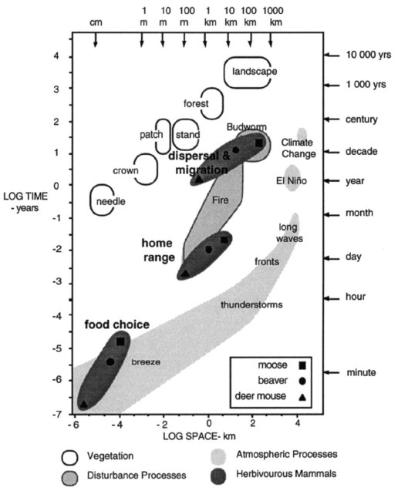
scaling
Ecosystems are nested at multiple scales
Small and large
Fast and slow
More and less of an infinite number of variables
Diagram: Stommel
Sweet spots (Harris)
“It depends…”
regional

Slide 5
Review of Issue Paper
Assumption: that a spatial approach is useful basis
Terminology
“statistical units”, “aggregation units”
Simplification, flexibility, accuracy
Must be applied at varying scales; ecosystems are inherently scaleless; choice of scale is related to purpose of account and nature of phenomena (“scale matching”)
Ecosystem accounts are a “platform technology”
Supports analyses, enables collection and organisation of data
Delineation vs. attribution
Statistical unit like business register (basic info), then
Additional attributes obtained by survey (data collection)

Slide 6
Review of Issue Paper (2)
Definitions
Statistical units
are the contiguous land, freshwater and marine surface areas to which information is attributed and which provides the basis to aggregate this information to regional, national and global levels.
Statistical units “belong” to an ecosystem, usually consisting of more than one statistical unit i.e. aggregations can make up a larger ecosystem.
Size of statistical units
The smallest statistical unit is based on observable core biophysical characteristics such as land cover, elevation (or depth in the case of water) and climate.
This information should be available for the entire country and available consistently for multiple time-periods at a resolution appropriate for the expected level of aggregation.

Slide 7
Review of Chapter 2 draft
SEEA EEA Objective: “The objects of measurement – the ecosystems – need to be defined from a statistical perspective”
P2.22 “there must be a clear focus for measurement”
P2.24 “… targeted at the macro level of analysis …”
P2.35- 2.29 Linking to economic units
P2.48-2.56 integration across scales
P2.1 “In the SEEA, ecosystems are areas containing a dynamic complex of biotic communities (for example plants, animals and micro-organisms) and their non-living environment interacting as a functional unit.”
P 2.10 single ecosystem can produce a range of ES
P2.22 “Further, ecosystems may be very small or very large and operate at different spatial scales”
P2.43-2.47 Ecosystem dynamics: Multiple states, irreversibility, complexity, lag effects, resilience

Slide 8
Review of Chapter 2 draft (2)
P2.23 “A statistical unit in ecosystem accounting is the contiguous areas of [similar ecosystem characteristics, such as] land cover (e.g. forest, wetland), to which information is attributed and which provides the basis to aggregate information to larger spatial areas, including at the regional, national and global levels.”
P2.25 “… starting point … Land Cover Units or LCU.” by land cover plus…
P2.26 “… information on the characteristics of LCUs should be available for an entire country and available consistently for multiple time-periods at a resolution appropriate for the expected levels of aggregation..”
P2.27 “LCU should be formed as contiguous areas of the same land cover type.” Suggest FAO LCC v3. CO: “more elaboration needed.”
P2.33 formation of “landscape units” – many ways to do it, including LC type.
P2.51 “Ideally, it would be possible to construct a register of land cover units containing standard information about these units. “
P2.52 “In statistical terms different “strata” of ecosystem would be designed and the characteristics would also form the basis for aggregations”

Slide 9
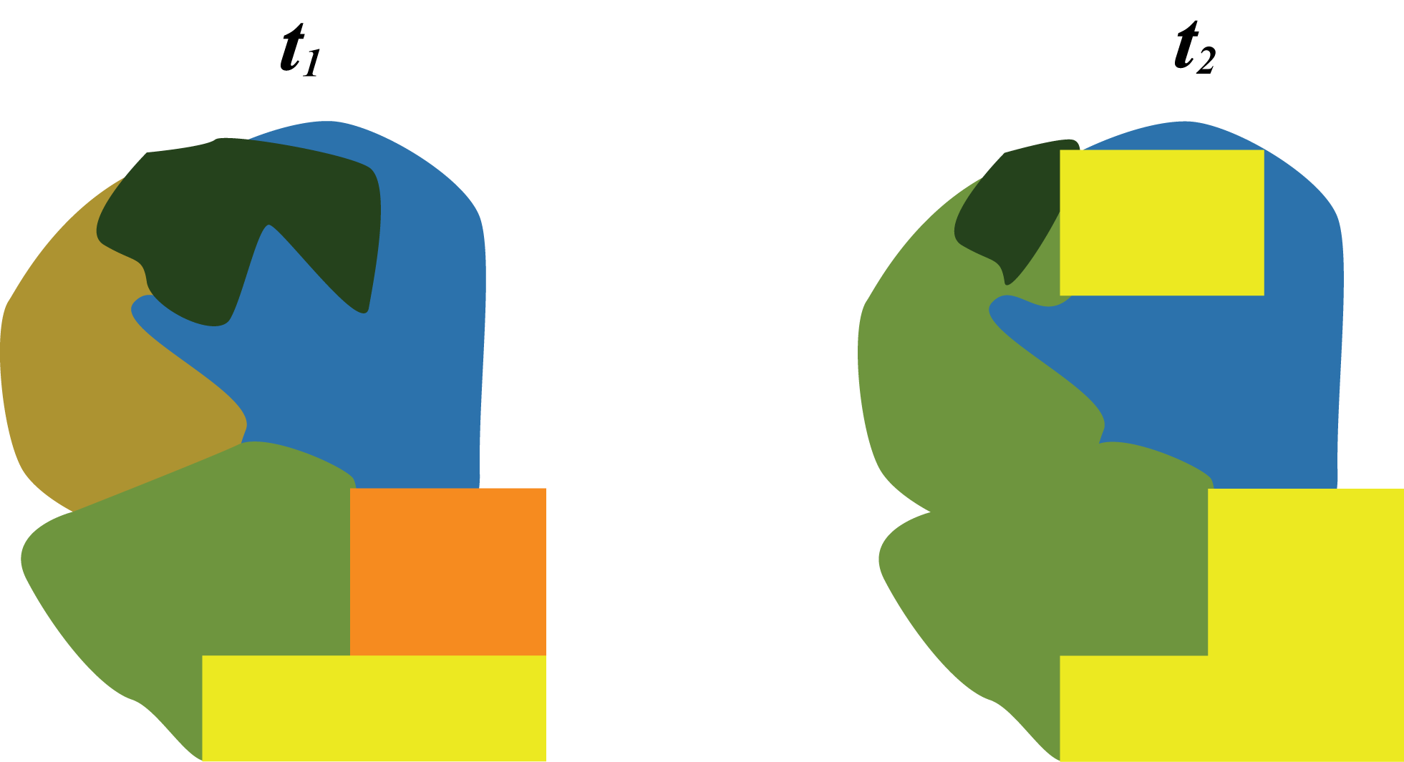
using land cover for ecosystem accounting

Slide 10
“classification of land cover units for ecosystem accounting”
SEEA Part 2 Ch2 draft:
FAO LCCS 3.0 (land cover types),
but further elaboration required
Proposal from Di Gregorio (FAO), Jaffrain (IGN-FI) and Weber (EEA)
“In SEEA volume 2, the classification process of land cover functional units for ecosystem accounting starts from the land cover types of Volume1
First step:
detailed land cover types
Second step:
definition of land cover flows and
land cover functional units”

Slide 11
Table 5. First sketch of aggregated Land Cover Functional Units (LCFU) classification
01 Urban and associated developed areas
02 Medium to large fields rainfed herbaceous cropland
03 Medium to large fields irrigated herbaceous cropland
04 Permanent crops, agriculture plantations
05 Agriculture associations and mosaics
06 Pastures and natural grassland
07 Forest tree cover
08 Shrubland, bushland, heathland
09 Sparsely vegetated areas
10 Natural vegetation associations and mosaics
11 Barren land
12 Permanent snow and glaciers
13 Open wetlands
14 Inland water bodies
15 Coastal water bodies
16 Sea (per memory)

Slide 12
Back to basics…
Sampling frame
Is a list of the “elements” (entities) within a population that can be sampled
“Units”, or “observational units”, refers to one member of a set of entities being studied.

Slide 13
Ideal sampling frame
An ideal sampling frame will have the following qualities:^{[1]}
all units have a logical, numerical identifier
all units can be found - their contact information, map location or other relevant information is present
the frame is organized in a logical, systematic fashion
the frame has additional information about the units that allow the use of more advanced sampling frames
every element of the population of interest is present in the frame
every element of the population is present only once in the frame
no elements from outside the population of interest are present in the frame
Sarndal et al, 2011

Slide 14
Application to ecosystems?
For a population of ecosystems?
Challenges
Ecosystems are multi-scaled, even scaleless e.g. Stommel
Ecosystems have complex emergent properties
Cost: available data is at particular scales

Slide 15
Key questions and issues
To what extent should statistical units be defined in relation to individual ecosystem services (which may operate at different spatial scales)?
At what level of specificity should the smallest statistical unit be defined and what information is needed to delineate this unit (is land cover sufficient)?
Should there be aggregations of statistical units and, if so, for what purpose and can any specific methods be recommended?
How should marine ecosystems and the atmosphere be considered in ecosystem accounting?
How should statistical units for ecosystems be linked to economic units?

Slide 16
ES as basis for selection
The selection of the accounts [and their spatial units] should be based on the basis of what are the most powerful general proxies that underpin a relevant bundle of services for each unit.
Capacity account 1: Land cover distribution
Capacity account 3: Carbon
 | Spatial unit 1 | Spatial unit 2 | …
Opening capacity = distribution of land cover types
Change = net changes for each type (forest, agriculture,…)
Closing capacity = distribution of land cover types
 | Spatial unit 1 | Spatial unit 2 | …
Opening capacity = stock of organic carbon in vegetation
Change = additions (NPP) minus removals (harvest, grazing, natural disasters)
Closing capacity = stock of organic carbon in vegetation

Slide 17
Key questions and issues
To what extent should statistical units be defined in relation to individual ecosystem services (which may operate at different spatial scales)?
At what level of specificity should the smallest statistical unit be defined and what information is needed to delineate this unit (is land cover sufficient)?
Should there be aggregations of statistical units and, if so, for what purpose and can any specific methods be recommended?
How should marine ecosystems and the atmosphere be considered in ecosystem accounting?
How should statistical units for ecosystems be linked to economic units?

Slide 18
Identification of an ecosystem statistical unit
Spatial constructor approach
Spatial tessellation (e.g. standard grid cell, 1 Ha, 1 Km)
3D tessellation (e.g. GOESS)
Then add thematic attributes; “I belong to … ecosystem”
Ecosystem thematic attribute approach
Fixed habitat: Land cover, functional unit, LCFU, SELU
Dynamic habitat: “hotspots”; marine (“key ecological features”), estuaries/rivers, air
Non-contiguous fixed habitat: groundwater dependent ecosystems (oases)
Non-contiguous dynamic ecosystems: migratory birds, pelagic fisheries
Cross-habitat ecosystems: salmon, eels, rock lobster,
Ecosystem service/s driven attribute approach
For particular bundle/set of ES, identify all ecosystems with capacity to supply
Doesn’t need specific spatial attributes
Ecosystem capital statistical unit
Quantity: may be spatial, but not only spatial (e.g. fish stocks)
Quality: condition may be highly complex and specific to account purpose and ecosystem
Capacity: is ES related, ecosystem understanding related, objective/target related

Slide 19
Defining an ecosystem “statistical unit”
Solutions??
Spatial constructors (“statistical assemblies”) can be used to construct ecosystem units
Ecosystem statistical units are constructed according to the population of interest as determined with criteria informed by the purpose of the account:
Ecosystem services (single, set (bundle))
Ecosystem capital
Low cost default: land cover and function based units
Other examples (including administrative aggregations)
SEQ via social process
Vic DSE via ecological modelling and economic criteria
SELU as socio-ecological criteria
MDBA sites of significance

Slide 20
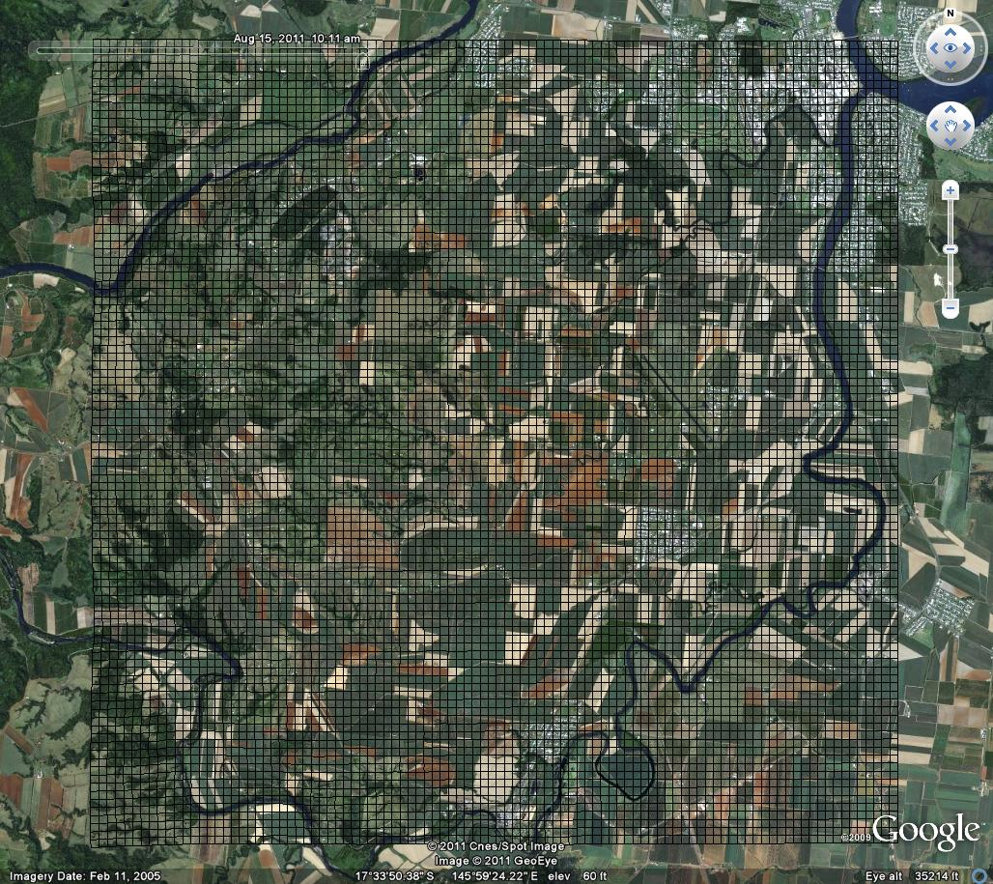
Spatial constructor (tessellation)

Slide 21
Key questions and issues
To what extent should statistical units be defined in relation to individual ecosystem services (which may operate at different spatial scales)?
At what level of specificity should the smallest statistical unit be defined and what information is needed to delineate this unit (is land cover sufficient)?
Should there be aggregations of statistical units and, if so, for what purpose and can any specific methods be recommended?
How should marine ecosystems and the atmosphere be considered in ecosystem accounting?
How should statistical units for ecosystems be linked to economic units?

Slide 22
Key questions and issues
To what extent should statistical units be defined in relation to individual ecosystem services (which may operate at different spatial scales)?
At what level of specificity should the smallest statistical unit be defined and what information is needed to delineate this unit (is land cover sufficient)?
Should there be aggregations of statistical units and, if so, for what purpose and can any specific methods be recommended?
How should marine ecosystems and the atmosphere be considered in ecosystem accounting?
How should statistical units for ecosystems be linked to economic units?

Slide 23
Marine and coastal
Linear shorelines with the intertidal zone as the central concept and then people extend landwards or seawards as they see fit
geomorphic (form and fabric) classification is basic unit (rather than land cover) i.e. soft/hard; then
muddy/sandy/gravelly/boulders/rocky;
then add life forms: mangroves, saltmarsh, seagrass, macroalgae
Then subtidal areas can be split into
The benthos (the bottom), which can be treated like land cover i.e. habitat mapping including via geomorphology (silt, sand, gravel, boulders, rock/coral) and
“Structural Macro Biota” (SMB), which are the living life forms that modify the surface (e.g. coral, sponges/filter feeders, seagrass etc.).
At broader scales there is a cascade of biogregions and provinces and biomes etc.
The water column including upwellings, eddy’s etc. – i.e. a 3D volumetric measure of some sort.

Slide 24
Key questions and issues
To what extent should statistical units be defined in relation to individual ecosystem services (which may operate at different spatial scales)?
At what level of specificity should the smallest statistical unit be defined and what information is needed to delineate this unit (is land cover sufficient)?
Should there be aggregations of statistical units and, if so, for what purpose and can any specific methods be recommended?
How should marine ecosystems and the atmosphere be considered in ecosystem accounting?
How should statistical units for ecosystems be linked to economic units?

Slide 25
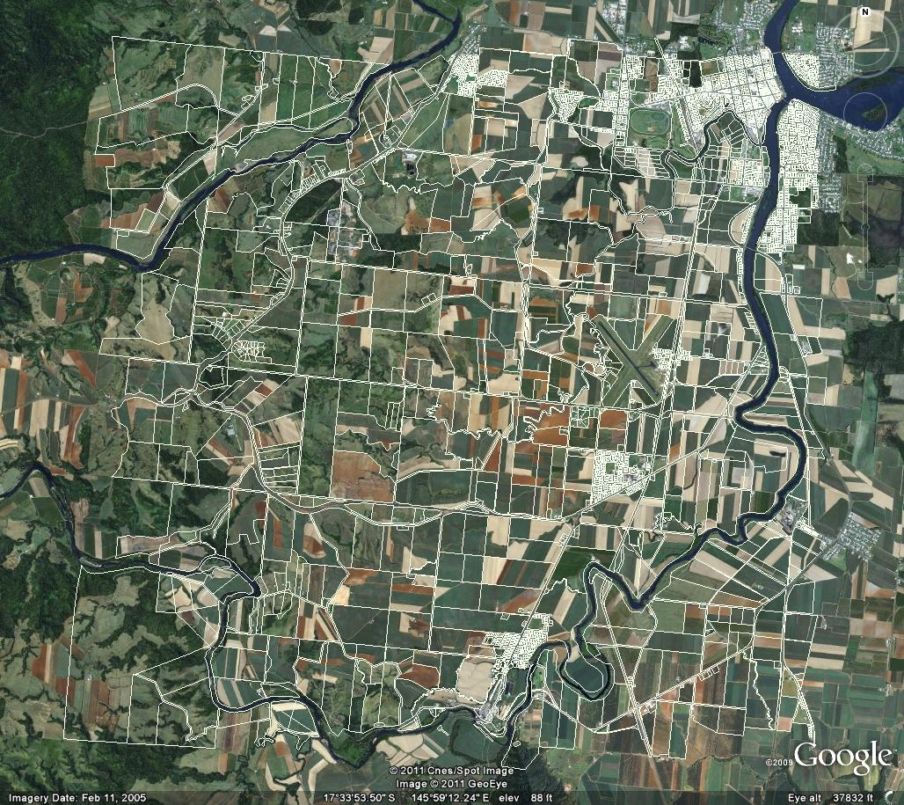
Cadastre based – connection to economic units

Slide 26
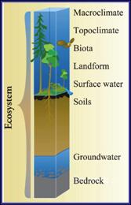
GEOSS – Group on Earth Observation System of Systems
Almost every definition of ecosystems regards them as essentially scaleless, that is, they can range in size from a grain of soil, a pond, a forest, the tundra biome, even to the earth itself. The scaleless nature of ecosystems has created a basic ecosystem conundrum—researchers and managers interested in a particular ecosystem will always "custom" delineate the shape, size, and location of the ecosystem according to the particular research or management application.
http://rmgsc.cr.usgs.gov/ecosystems/method.shtml

Slide 27
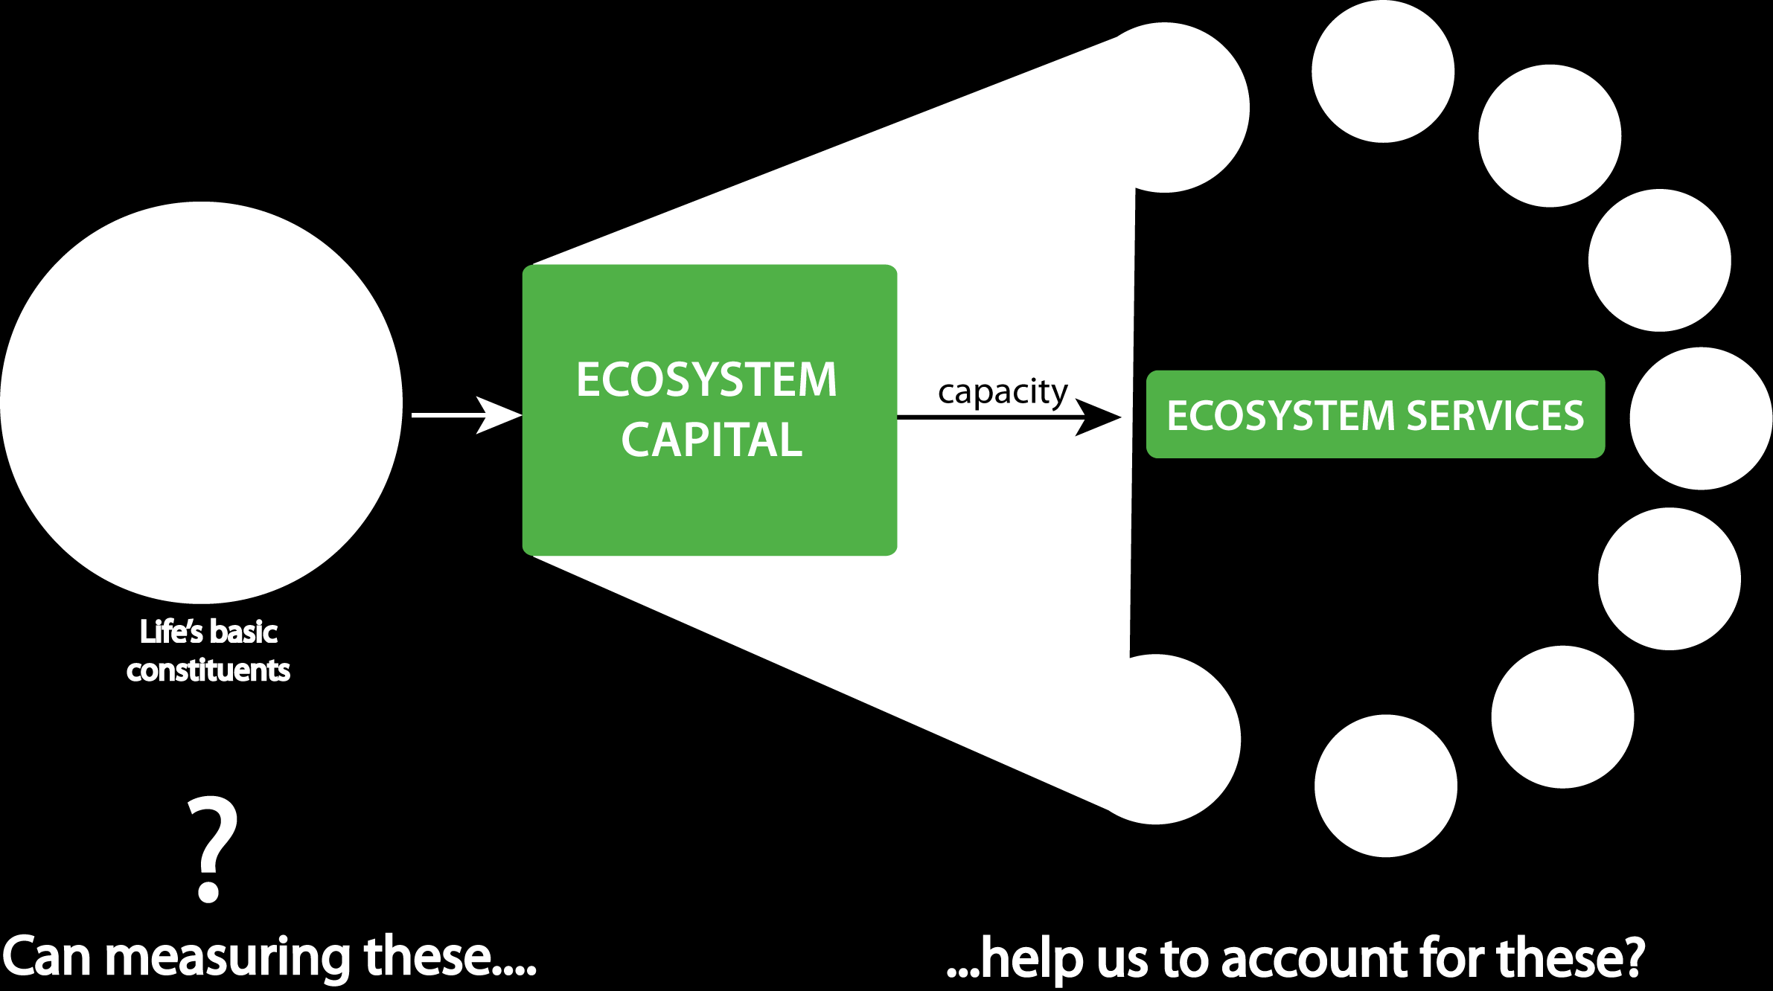

Slide 28
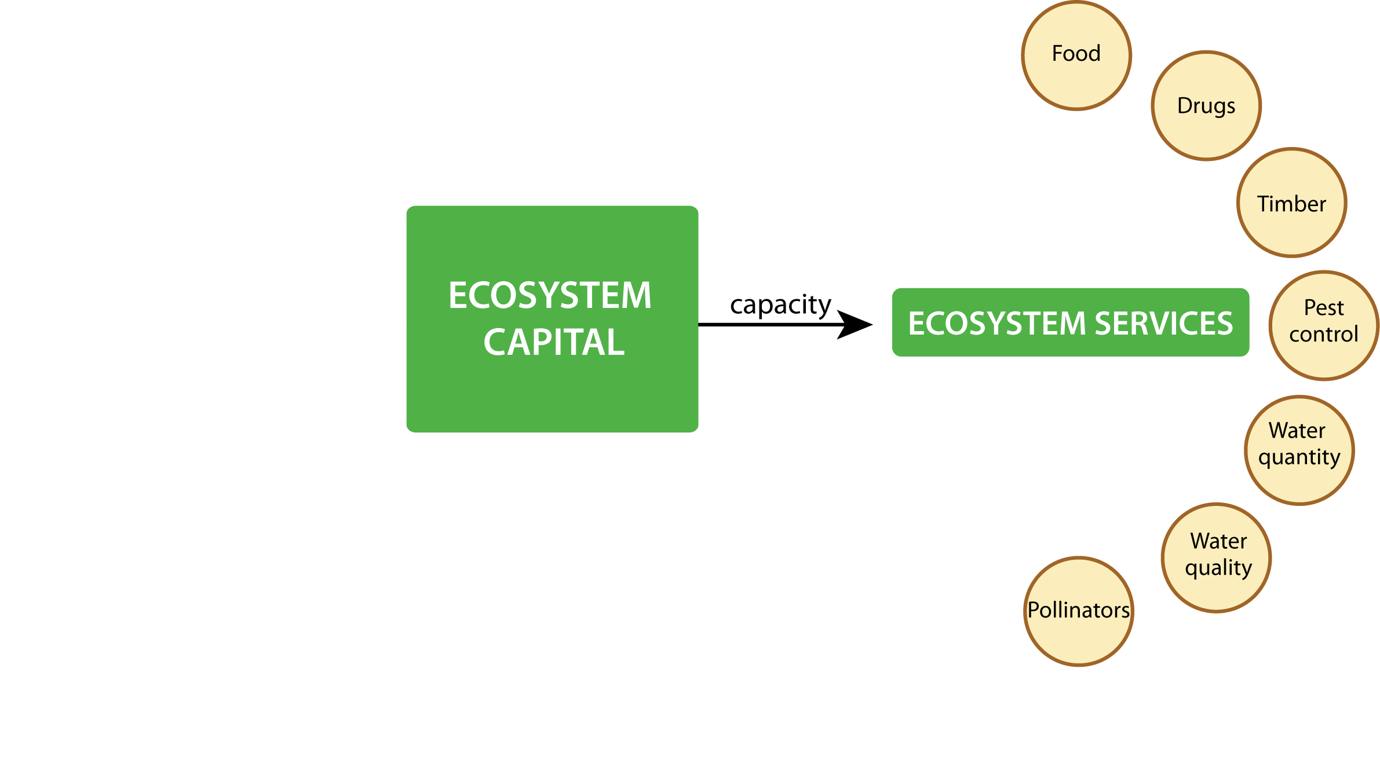

Slide 29
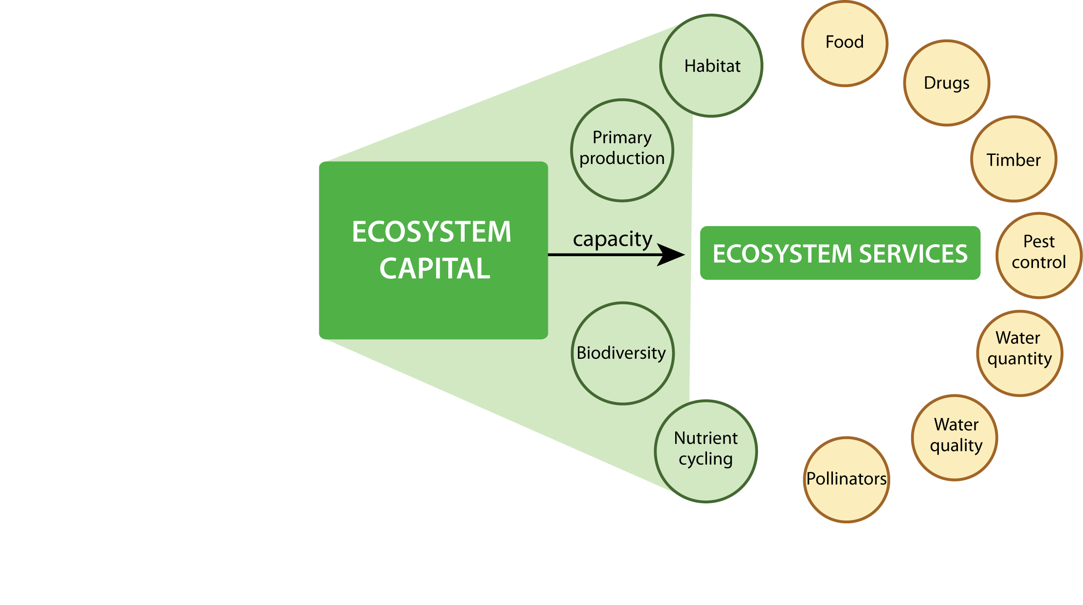

Slide 30
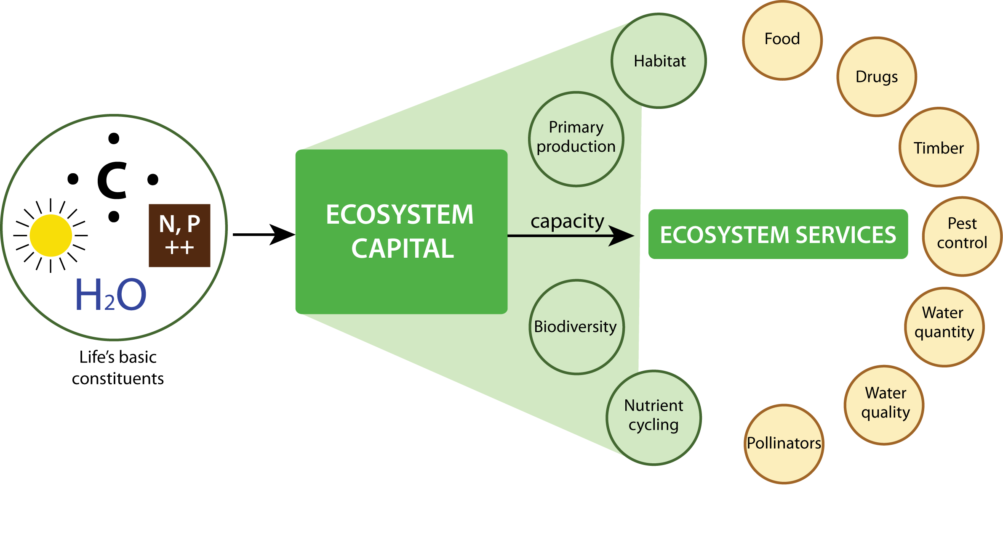

Slide 31
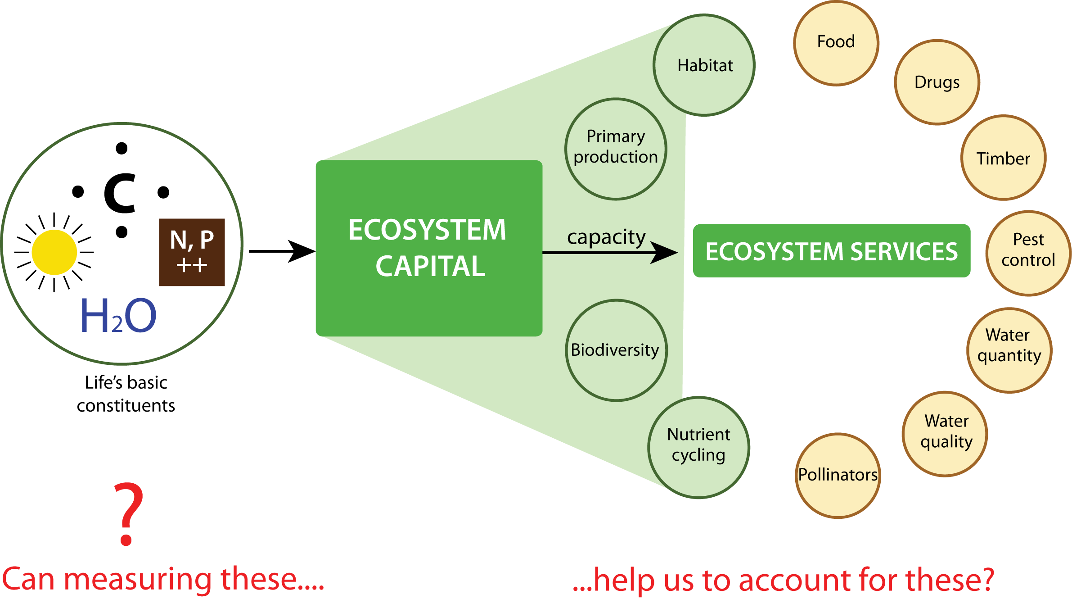

Slide 32
Society
Economy
Ecosystems and Environment

